Slide 1
Department of Housing For All, Haryana State

Slide 2
About us
To achieve the vision of Hon’ble Prime Ministry, State Government has created a new department, Department of Housing For All as a nodal agency for the housing need for the Urban and Rural areas w.e.f 15.12.2020

Slide 3
Videos

Slide 4
Assistance to Beneficiaries
Financial Assistance | Rs.1.20 Lakhs
 | Rs. 0.18 lakhs Top up amount (in addition to State Share)
Total | Rs.1.38 lakhs
Construction of toilet | Rs.0.12 lakh for construction of toilet under SBM
Additional Assistance | Rs.0.29 lakhs (90 unskilled man-days wages under MGNREG Scheme to job card holder)
The beneficiaries may (optional) also avail a bank loan uptoRs. 70,000/-

Slide 5
ACHIEVEMENTS
 | Year | Targets | Houses Sanctioned | Houses completed | Incomplete houses
1st phase | 2016-17 | 11668 | 11668 | 11573 | 95
 | 2017-18 | 9298 | 9298 | 9219 | 79
 | Total | 20966 | 20966 | 20792 | 174
 | 2020-21 | 701 | 701 | 578 | 123
A | Total | 21667 | 21667 | 21370 | 297
2nd Phase | 2021-22 | 7773 | 7773 | 4939 | 2834
B | Total | 7773 | 7773 | 4939 | 2834
 | Grand Total (A+B) | 29440 | 29440 (100%) | 26309 (89.36%) | 3131
All the houses except the beneficiaries who died /left the village without legal heir will be completed by 30.09.2023

Slide 6
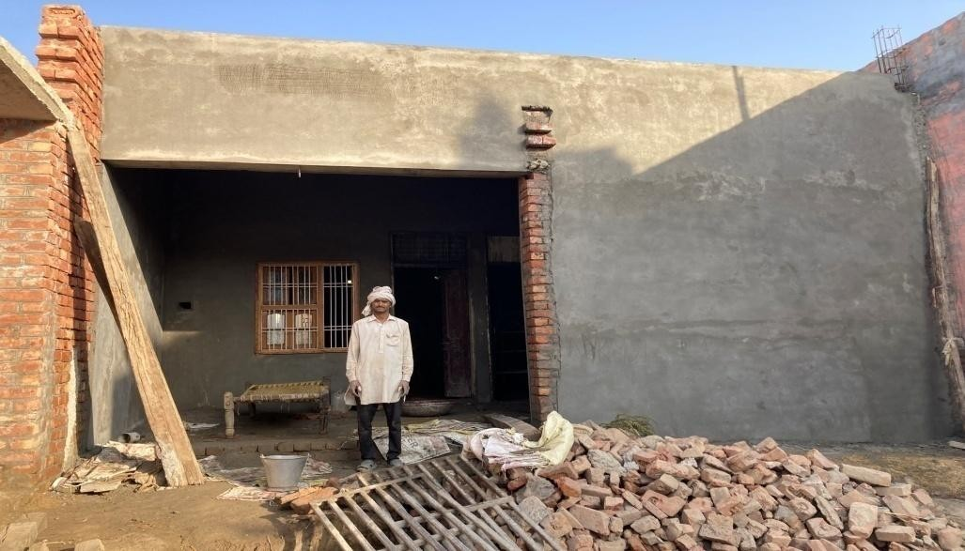
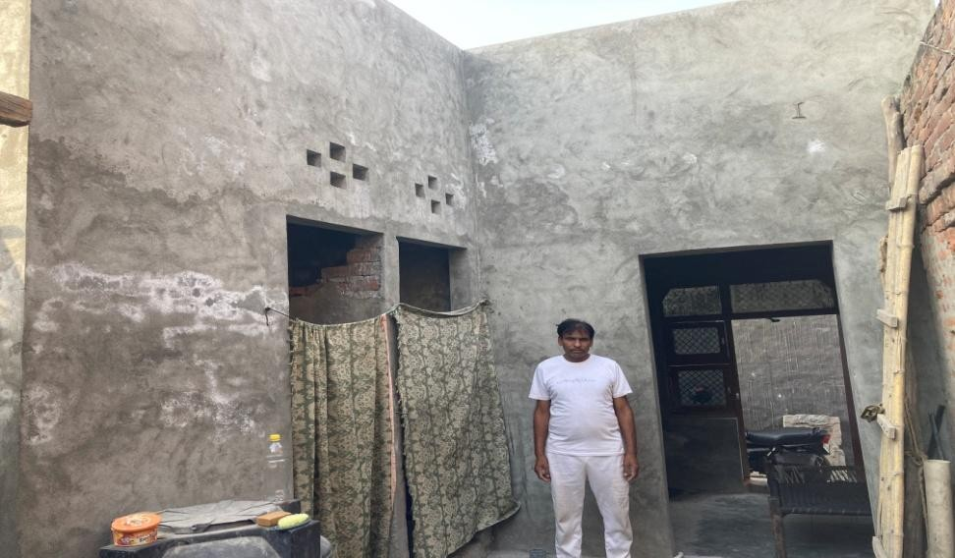
Awaas Plus Success Stories
1-Ramniwas s/o Sh. Banwari
2-Satish S/o Sh. Zile Singh
GP Naraina, Tehsil Samalkha, Panipat
GP Kiwana, Tehsilamalkha, Panipat

Slide 7
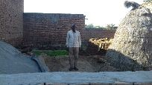
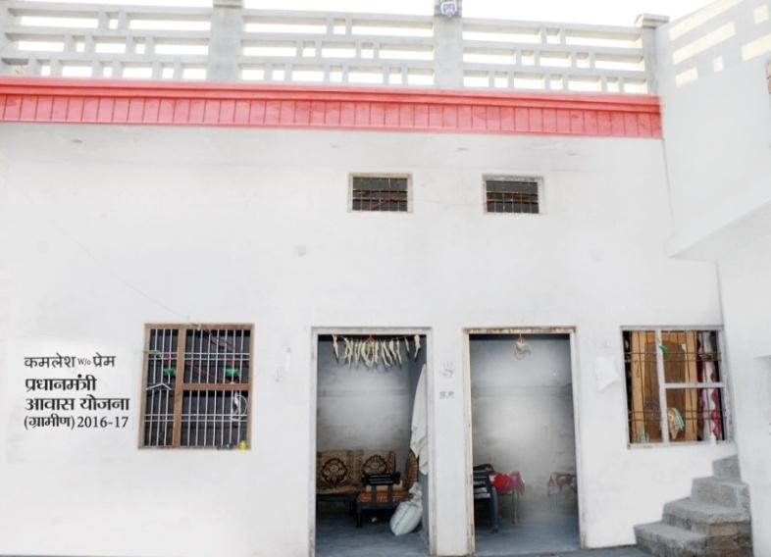
Before Construction
After Construction

Slide 8
FINANCIAL PROGRESS
Status of Central share release under PMAY-G
Year | Target | Funds to be Released by Government of India (in lakhs) | Funds Released Government of India (in lakhs) (as on 08.08.2023) | Balance to be released Against the target (in lakhs)
2016-17 | 11668 | 8400.96 | 6878.3 | 0
2017-18 | 9298 | 6694.56 | 2308.3 | 0
2018-19 | 0 | 0 | 2839.56 | 0
2019-20 | 0 | 0 | 0 | 0
2020-12 | 701 | 504.72 | 3455.28 | 0
2021-22 | 7773 | 5596.56 | 0 | 0
2022-23 | 0 | 0 | 4421.52 | 0
2023-24 | 0 | 0 | 0 | 0
Total | 29440 | 21196.80 | 19902.96 | 1293.84

Slide 9
* Note
The State Govt. has released Rs. 92.09 crore in advance from State budget on recoup basis out of which Rs. 73.69 crore have been recouped. No Central/State share from treasury to SNA is pending.
The Audit statement and balance sheets for the year 2022-23 along with proposal for release of funds will be submitted to the Ministry by 20.08.2023

Slide 10
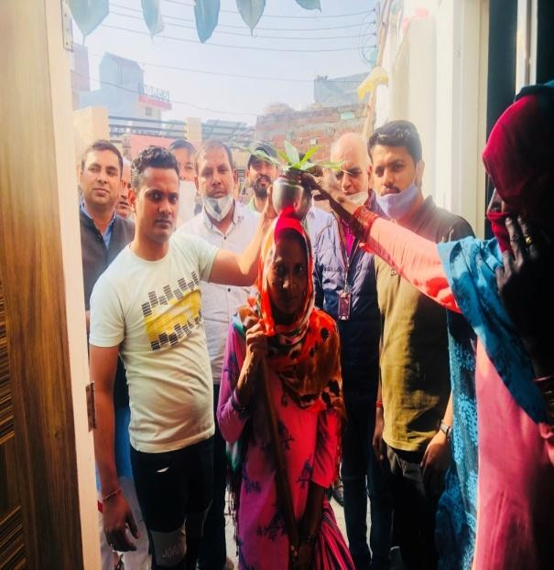
Griha Parvesh Activity

Slide 11
CONVERGENCE STATUS
Total Sanctioned | Total Completed | Toilet Constructed | Electricity Connection | LPG Connection | Water Connection | SHG
29440 | 26309 | 24383 | 24796 | 24109 | 22876 | 2103

Slide 12
AADHAR SEEDED STATUS
State | Payment done
Haryana | 7697

Slide 13
Social Media Activities

Slide 14
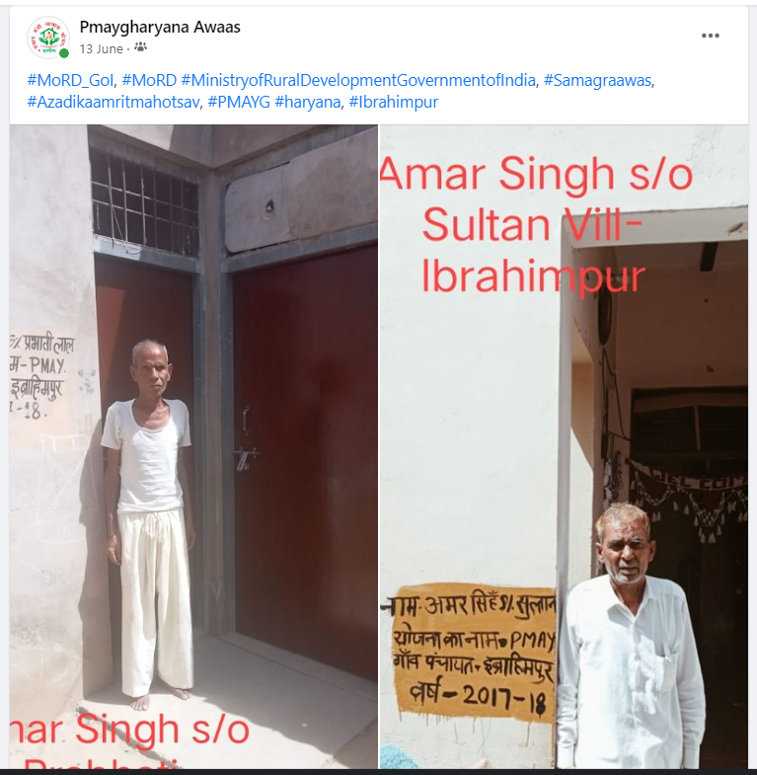

Slide 15
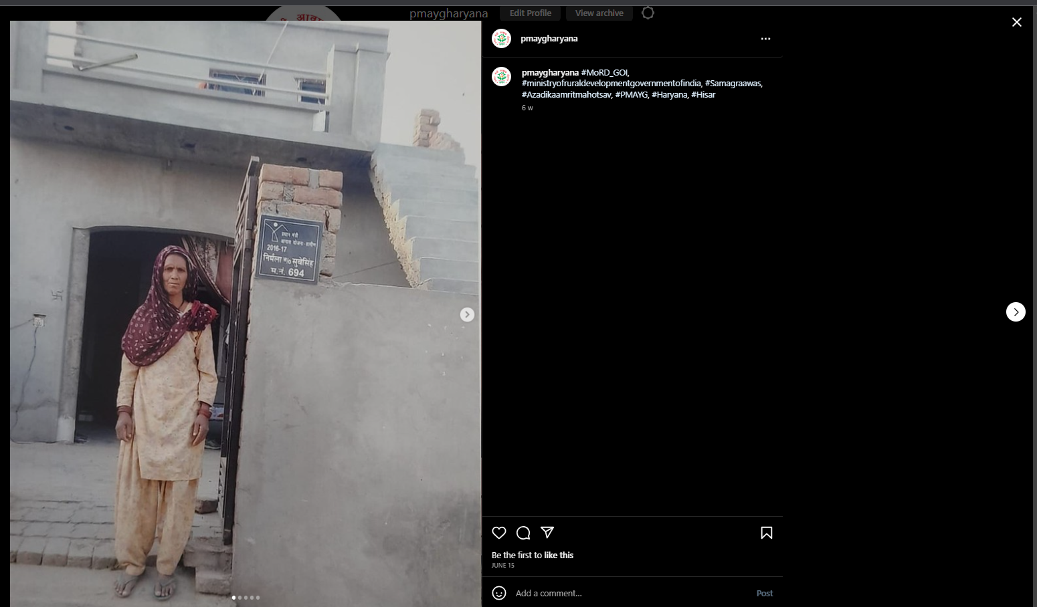

Slide 16
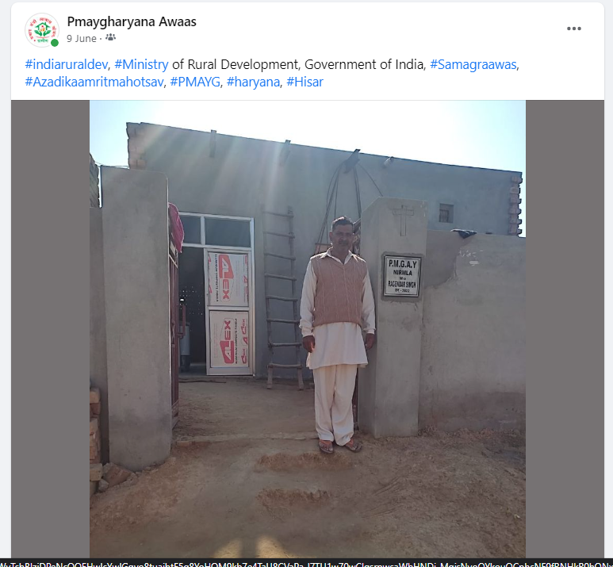

Slide 17
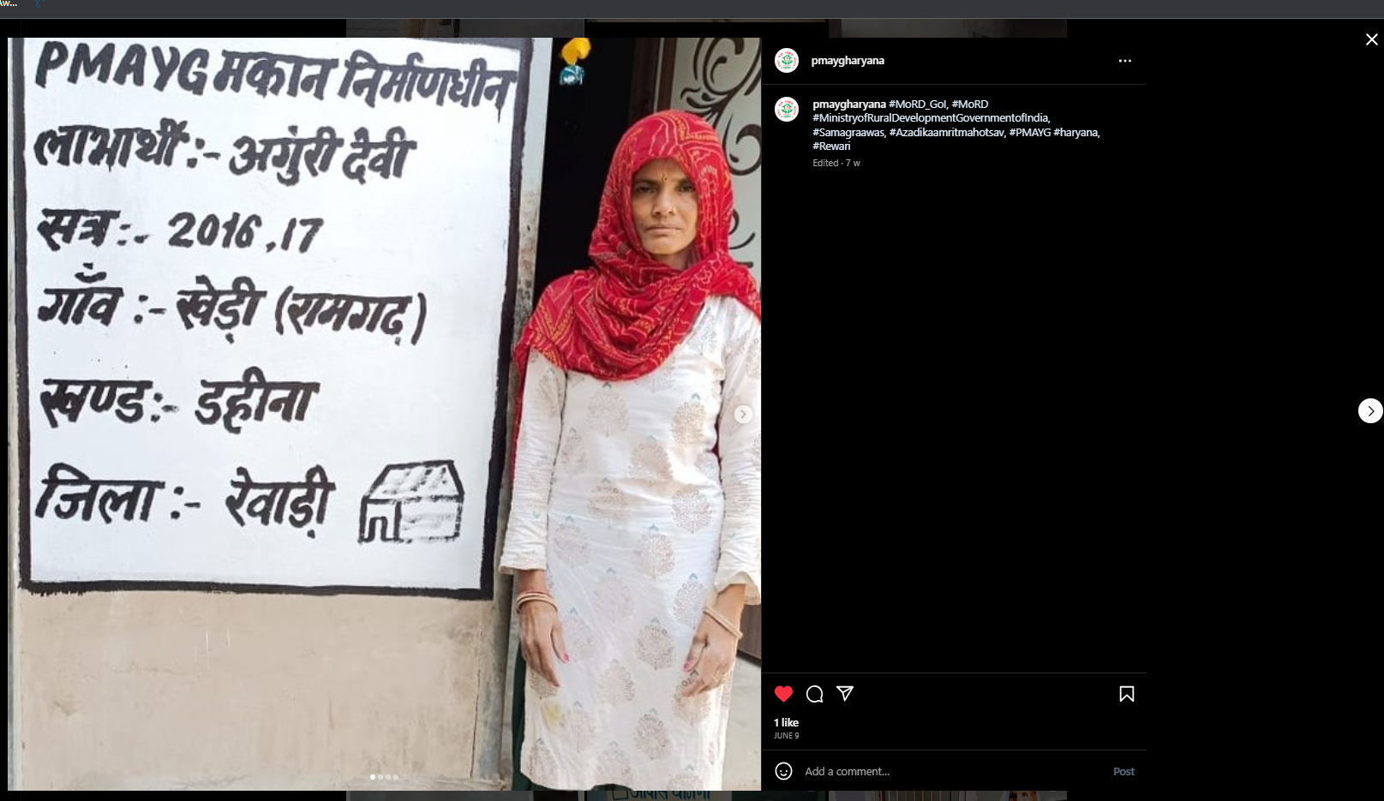

Slide 18
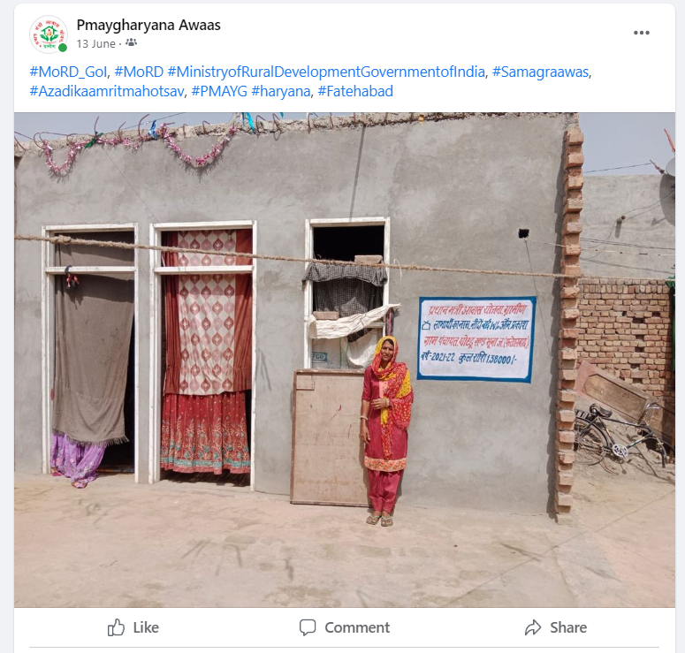

Slide 19
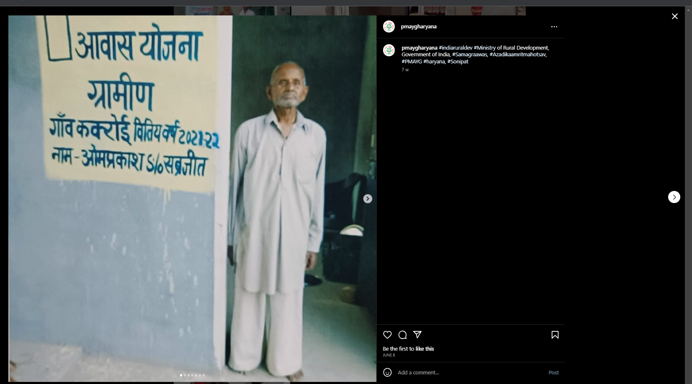

Slide 20
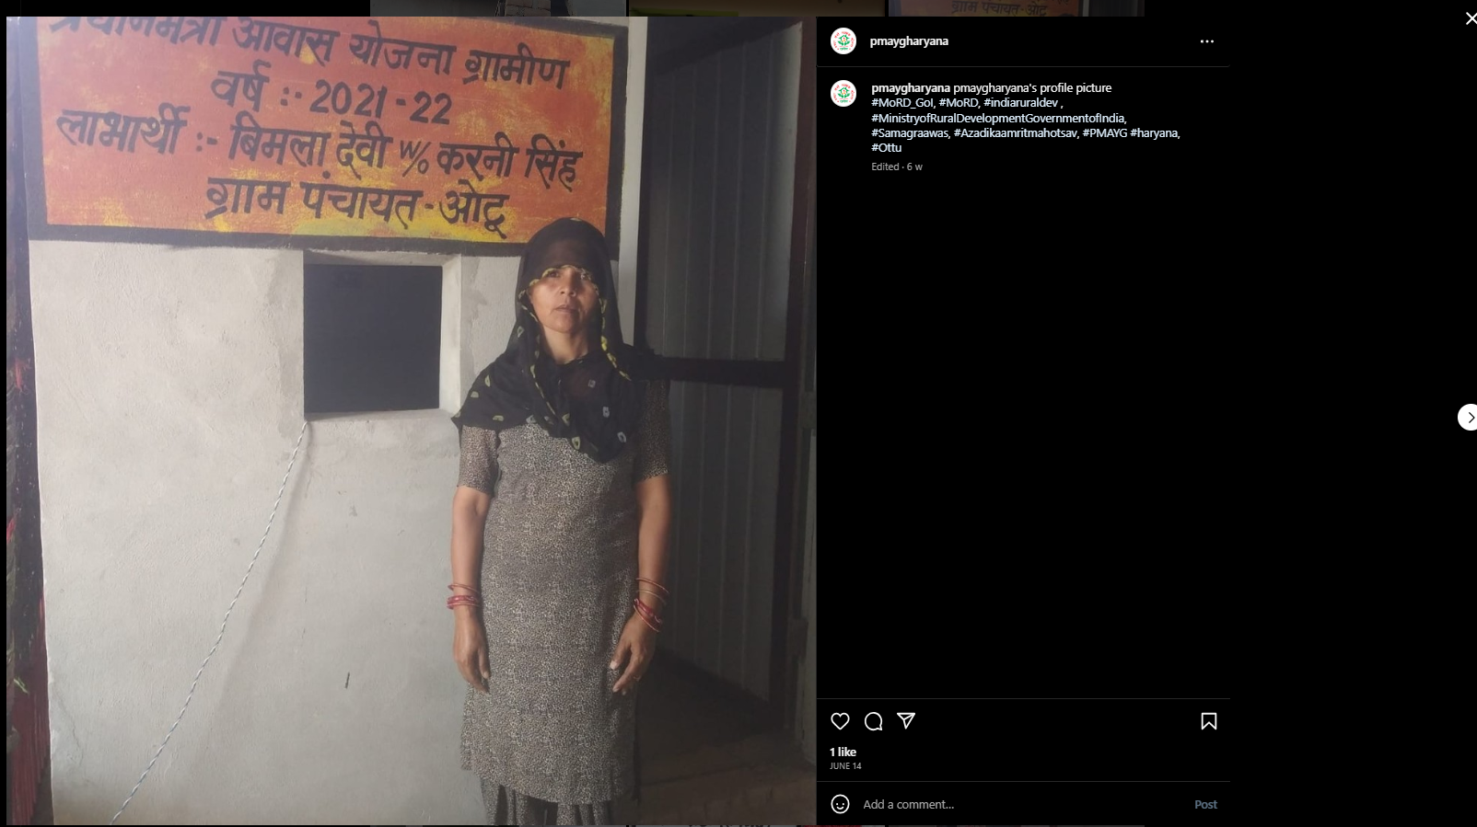

Slide 21
Thank You

